Slide 1
Fabry-Perot Resonator
This slide show demonstrates how the transmission as a function of optical frequency is affected by finesse of the cavity.
Use the left and right arrow keys to sequence through the slides to change the finesse of a plane-plane Fabry-Perot resonator. The value of finesse is shown in the upper right corner of each slide.

Slide 2
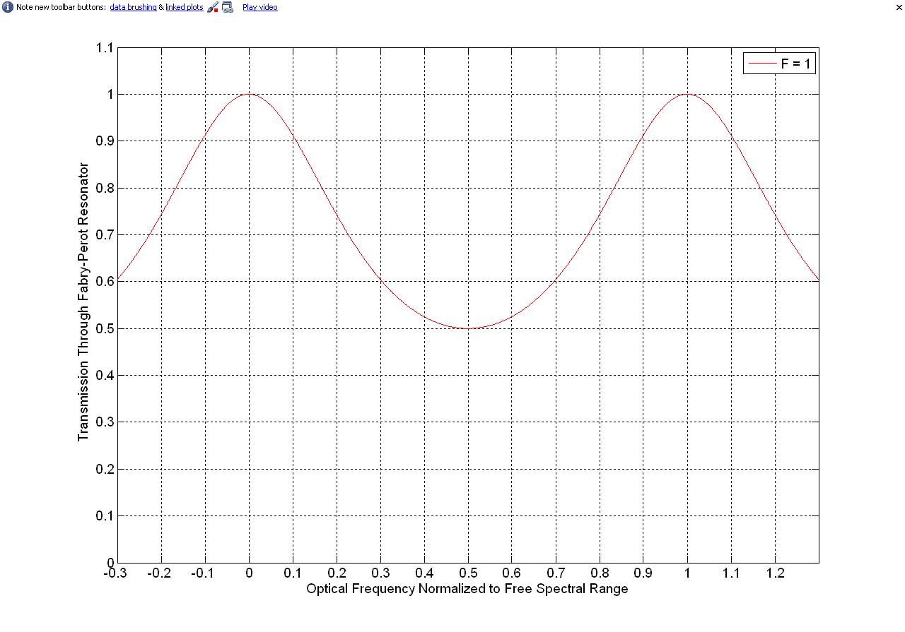

Slide 3
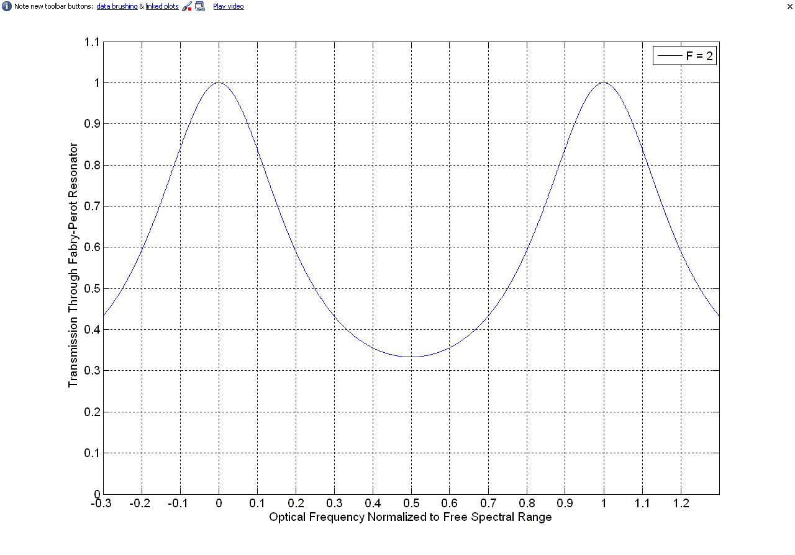

Slide 4
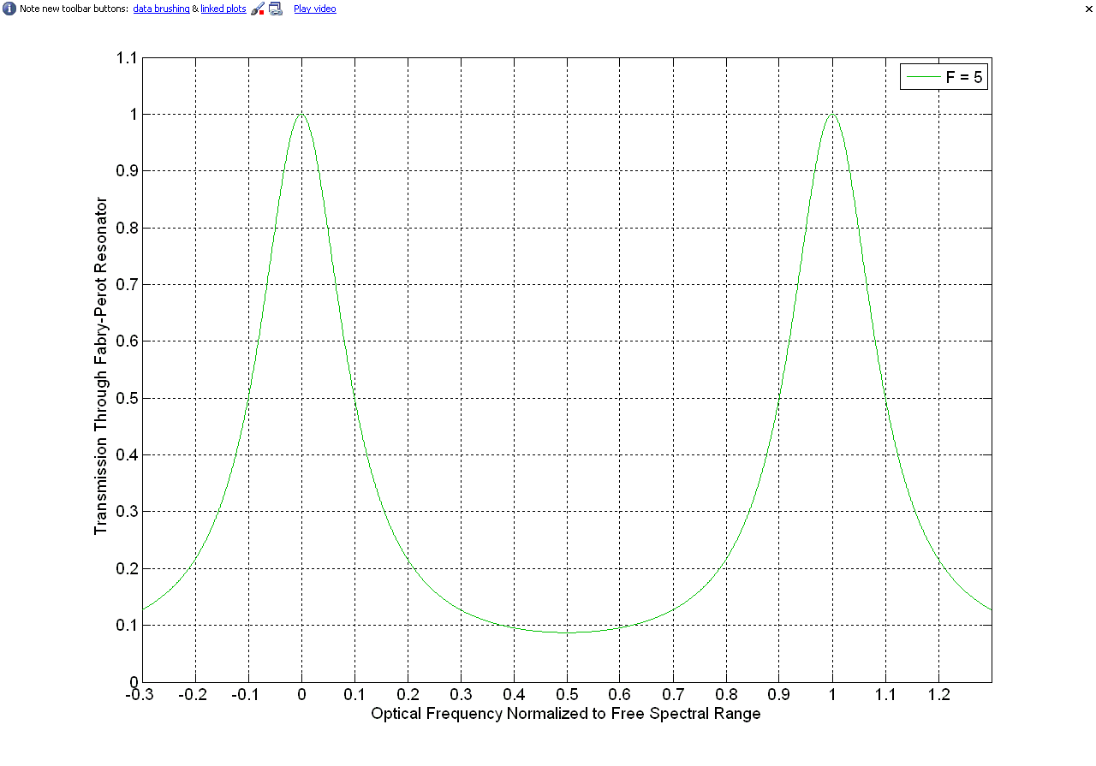

Slide 5
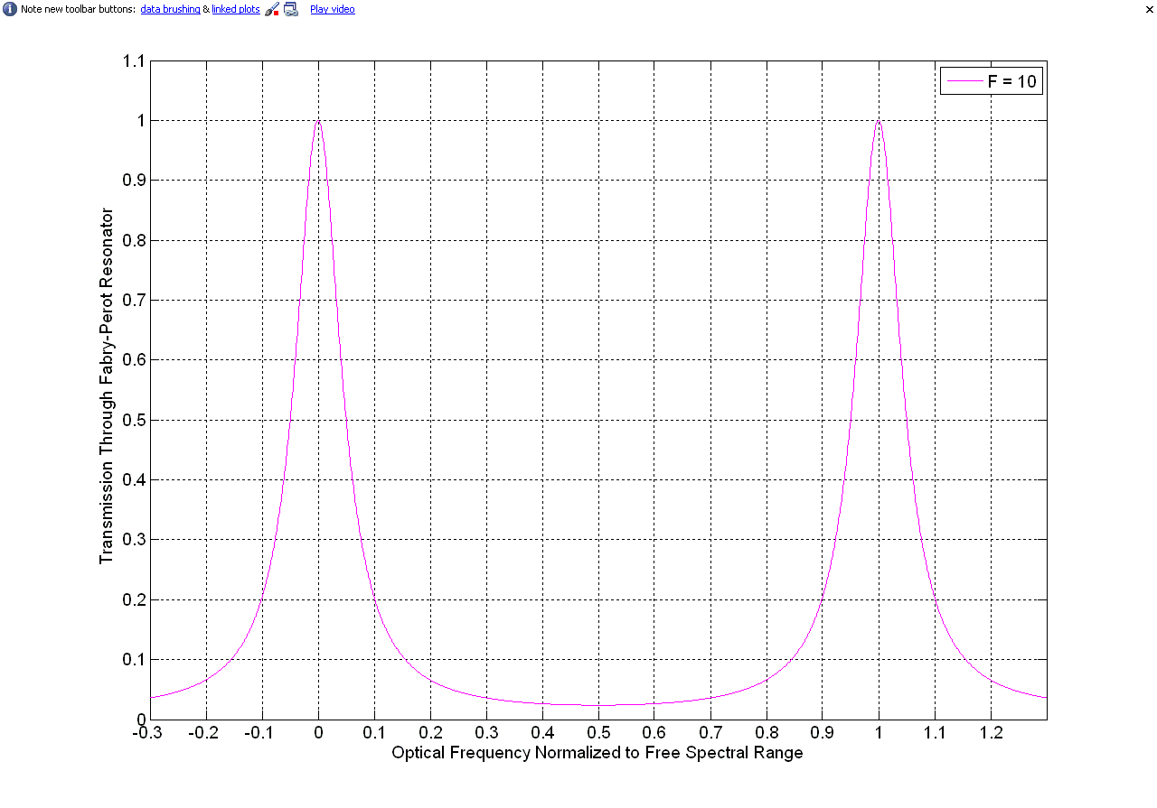

Slide 6
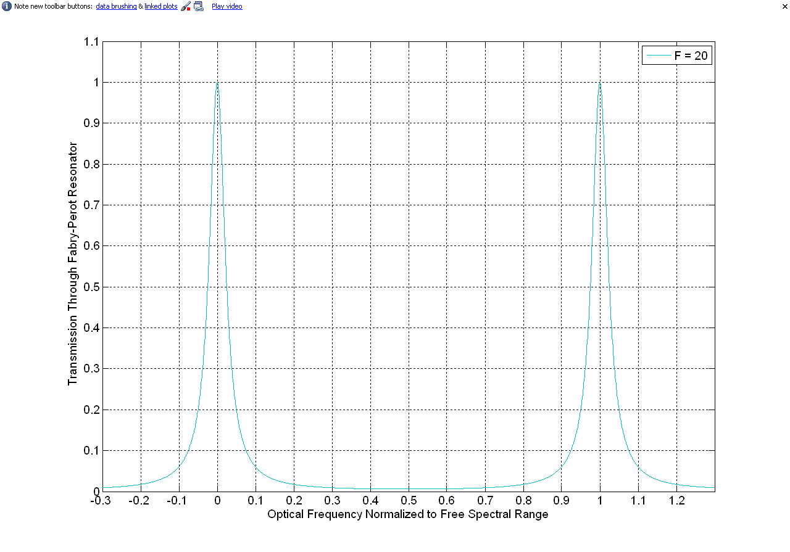

Slide 7
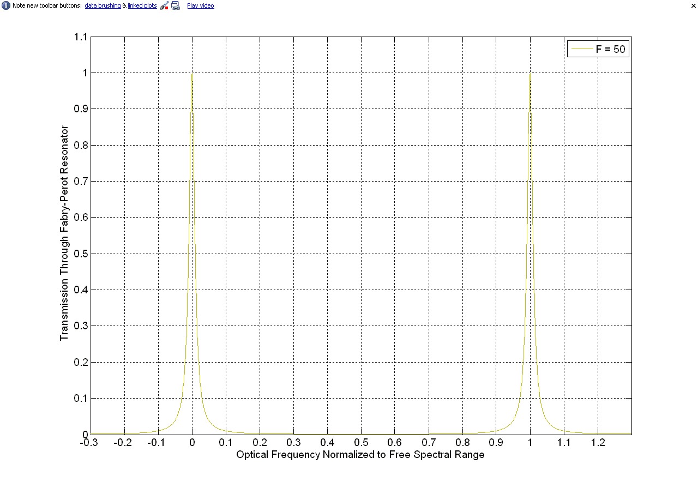

Slide 8
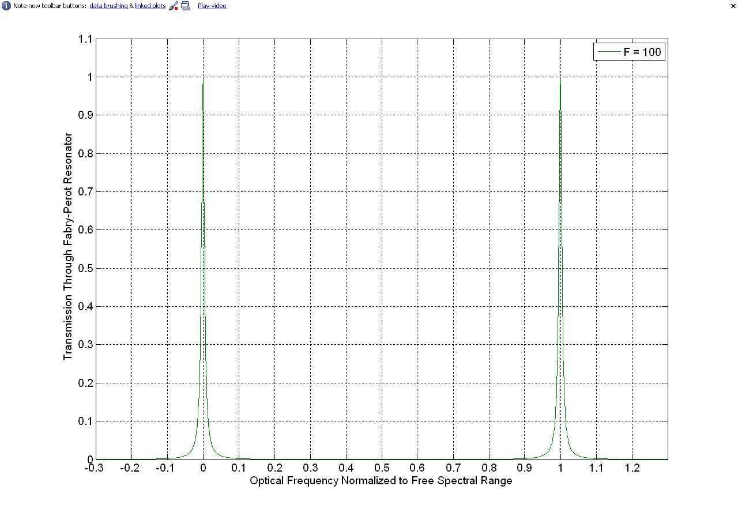

Slide 9
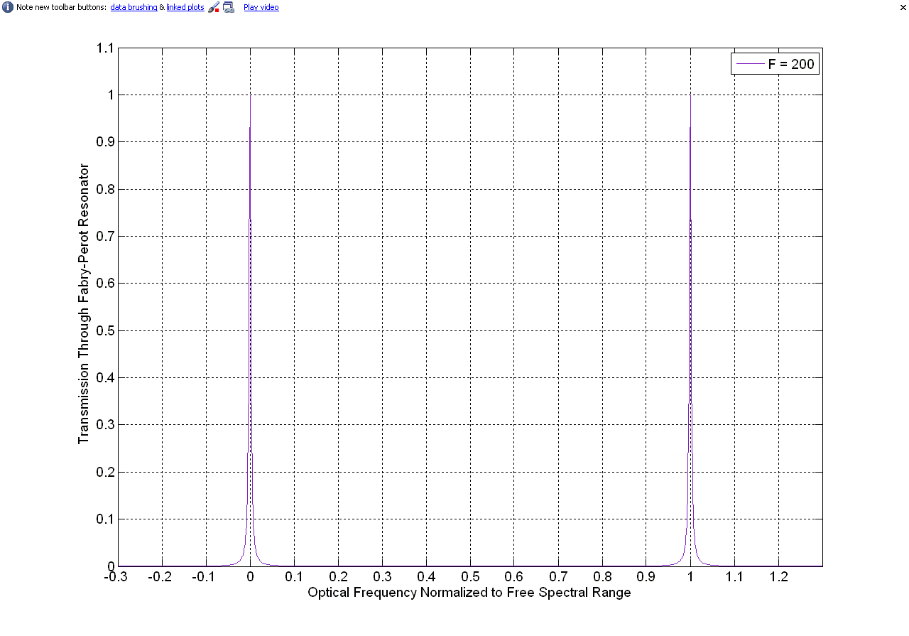

Slide 10
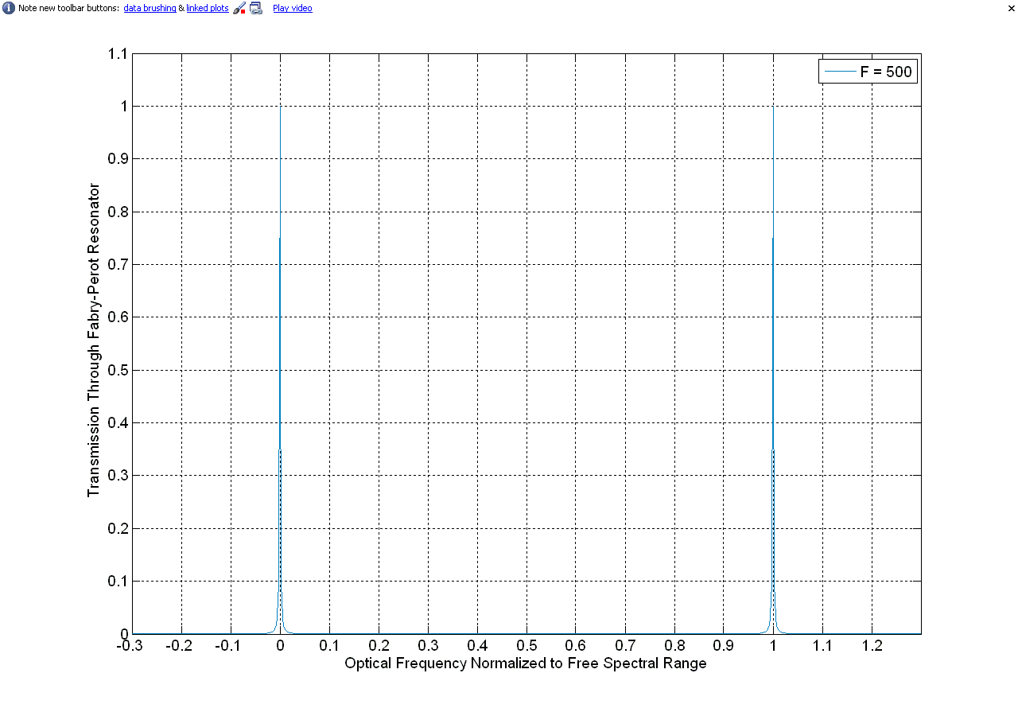

Slide 11
